Slide 1
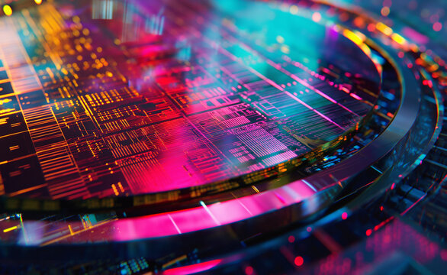
Electrophoretic
Deposition
Thin Film Synthesis Method
MME 408
Student ID :
2011049
2011050
2011051
2011052
2011053 Md. Atik Faisal
2011054

Slide 2

What is EPD?
A colloidal processing technique
Uses electrophoresis to deposit charged particles onto substrate from suspension
Performed under an applied electric field

Slide 3
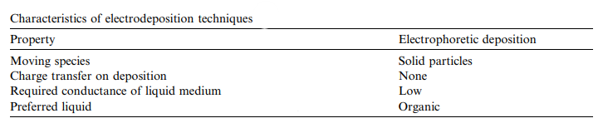
Characteristics of EPD

Slide 4
Overview
Fundamentals
Process Details
Applications
Advanced Topics

Slide 5
Process Components
Suspension
Charged Particle
Dielectric Medium
Stabilizing Agents
Electrode System
Working Electrode
Counter Electrode
Electrode Materials
Power Supply
DC Voltage Source
Current Control
Monitoring Systems
Cell Geometry
Electrode Spacing
Temperature Control
EPD Cell

Slide 6
Critical Parameters:
Applied Voltage (10-200V)
Affects deposition Rate and film uniformity
Deposition Time (1-30 minutes)
Controls film thickness and density
Particle Concentration (0.5-20 g/L)
Influences Deposition kinetics
Current Density (1-100 mA/cm2)
Indicates process efficiency

Slide 7
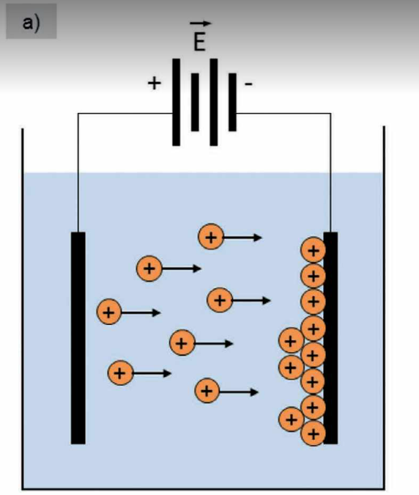
Electrophoresis Fundamentals :
Suspension of charged particle in liquid medium
Application of electric field
Migration of charged particle toward oppositely charged electrode
Accumulation at electrode surface
Particle deposition & film formation
Applicable to electrically conductive surface

Slide 8
Mechanism
Charge Development
Charge arises from :
Ion Adsorption
Dissociation
Electron transfer
Surface Charge control VITAL for EPD success

Slide 9

Mechanism
Charge Development
Aqueous Solution :
Charge depends on pH
Point of Zero charge e pH value where the surface
concentration of (S–O-) and S–OH2+ are equal
Negative at pH > pHpzc and positive at pH < pHpzc
Non-Aqueous Solution:
Charge depends on donor/acceptor number
Not enough free pprotons/hydroxyl ions

Slide 10
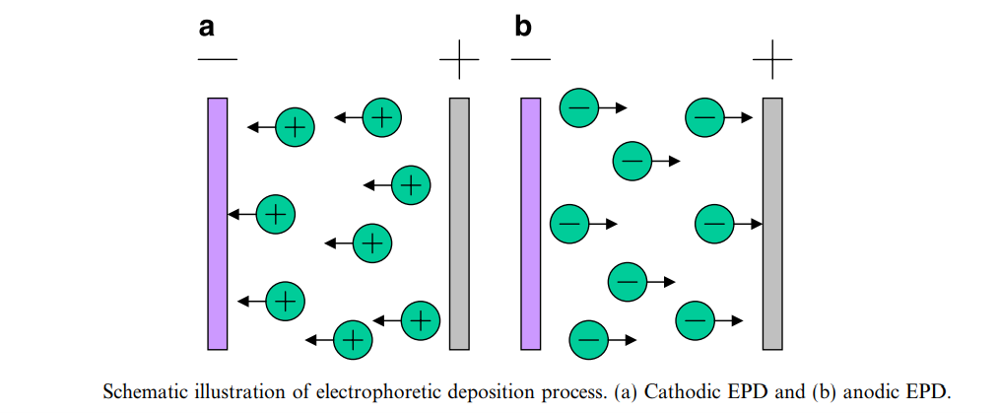

Slide 11
Mechanism
Electric Double Layer & Electrophoretic Mobility
After charging – Formation of Electrical Double Layer
The layer attracts Counter ions
Application of electric field- particles move-
Electrophoretic Mobility

Slide 12
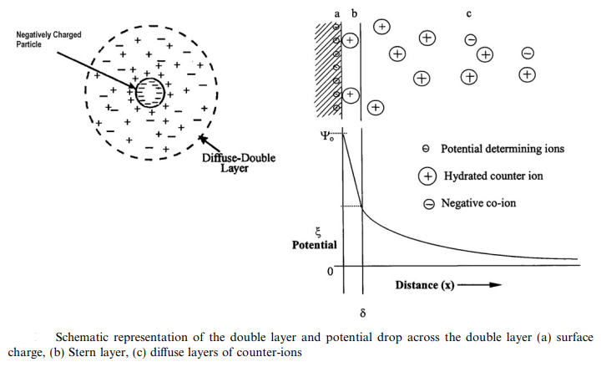
Mechanism
Electric Double Layer & Electrophoretic Mobility
Double layer contains:
Surface Charge
Stern Layer
Diffused charge
--The graph shows potential drop across the layer
--The edge of stern layer –
Zeta Potential -key factor in mobility

Slide 13
Mechanism
Particle Deposition
Two Step Process:
Migration
Depends on Field Strength and Particle Movement
Deposition
It involves particle aggregation and charge loss

Slide 14
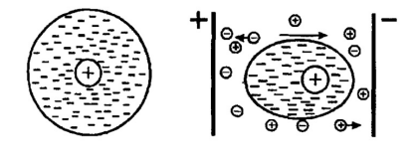
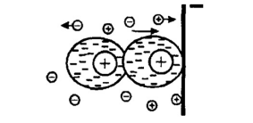
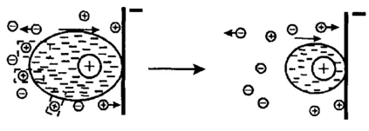
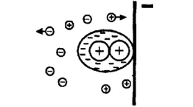
Mechanism
Particle Deposition
3.Electrochemical Coagulation :
Electrode's electric field changes ion concentration, lowering repulsion and coagulating particles
1.Flocculation :
Particles accumulation due to incoming pressure
2.Charge Neutralization :
Contact with electrode neutralizes particles
4.Electrical Double Layer Distortion and Thinning :
Flow and field distort the double layer, reducing repulsion and helping in settling

Slide 15
Process steps:
1. Suspension Prep
• Stable, charged, and well-dispersed colloid
2. Electrode Setup
• Substrate + counter-electrode in suspension
• Connected to DC power (polarity depends on charge)
3. Deposition
• Voltage drives particle migration
• Thin film forms on substrate
• Controlled by time, voltage, suspension
4. Post-Treatment
• Drying or annealing to enhance film quality

Slide 16
Traditional Applications
Ceramic Films
Wear resistant, thermal and electrical insulator
Protective Films
Environmental barrier, corrosion & chemical resistance
Electronic Components
Resistor coating, dielectric layer
Automotive Industry
Paint primer coat, functional coat and decorative coat

Slide 17
Advanced Applications
Functional Thin Films:
Used in solid oxide fuel cells, sensors, solar cells, and electronic devices
MOF Thin Films:
EPD has been used to deposit MOF microcrystalline onto conductive glass, retaining their structure and enabling electrochemical applications
Graphene Oxide Films:
EPD allows rapid, uniform deposition of graphene oxide films, with controllable reduction and improved conductivity
Solid Oxide Fuel Cells:
EPD is favored for depositing dense, gas-tight electrolyte films with thicknesses of several micrometers, improving cell performance

Slide 18




Advantages:
Uniform Coating:
EPD enables highly uniform, pinhole-free coatings, even on complex geometries
Thickness Control:
Film thickness can be precisely controlled by adjusting deposition parameters (time, voltage, particle concentration)
Material Versatility:
Suitable for a broad range of materials—ceramics, polymers, MOFs, graphene, and more
Scalability and Cost-Effectiveness:
Simple equipment and process make EPD attractive for large-scale and industrial applications2.

Slide 19
Disadvantages
Substrate & Particle Limits
• Needs conductive substrate
• Only works with charged particles
Process Sensitivities
• pH-sensitive behavior
• Solvent compatibility issues
Side Reactions & Stability
• Electrolysis interference
• Suspension stability problems
Coating Challenges
• Hard to coat insulators
• Edge deposition effects

Slide 20
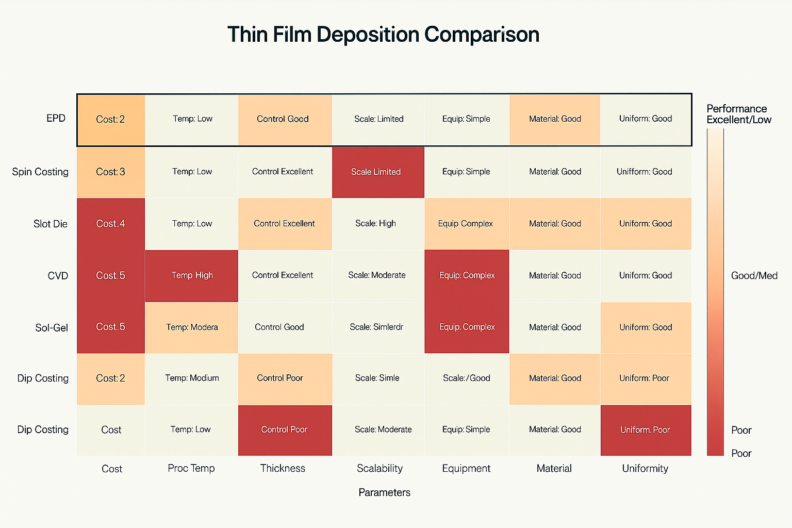

Slide 21
Thank You

